Slide 1
Volume 2: Section 4
Infection Prevention and Control in special settings

Slide 2
Volume 2_Section 4
CHAPTER 1:
SAFE SURGERY AND SAFE PRACTICE IN THE OPERATION ROOM
Infection Prevention and Control in special setting

Slide 3
Chapter Content
Overview of Safe Surgery
The Safe Surgery Guidelines
Establishing surgical asepsis
The Surgical Environment
Instruments Causing Injuries
Designing Safer Operations

Slide 4
Learning Objective
By the end of this chapter, participants will be able to:
Explain proven safe surgical care standards.
Identify the operating room and associated risks for patients and the staff.
Identify Instruments as a cause of most injuries in the operating room.
Describe how to avoid injuries from sharps and designing a safe operation room.

Slide 5
1. Overview of Save Surgery (1/1)
Each year, millions of people undergo surgical treatment due to traumatic injuries, pregnancy-related complications and malignancies.
Surgery is often the only therapy to alleviate disabilities and reduce the risk for death from common conditions.
Infections and other postoperative morbidities are also a serious problem prevailing around the world.
Monitoring and evaluation of outcomes is an essential component of surgical care.

Slide 6
2. The Safe Surgery Guidelines
(1/5)
2.1. The implementation of the safe surgery checklist.
2.2. The monitoring and evaluation of surgical outcomes

Slide 7
2.1. The Implementation of The Safe Surgery Checklist (2/5)
The Checklist involves the coordination of the operating team to discuss key safety checks prior to specific phases:
“Sign In” prior to induction of anesthesia
“Time Out” prior to skin incision
“Sign Out” before the team leaves the operating room.

Slide 8
10 Basic Essential Objectives Which Are Congruent To Safe Surgery Guidelines (3/5)
In any surgical case:
1. The team will operate on the correct patient at the correct site.
2. The team will use methods known to prevent harm from administration of anesthetics, while protecting the patient from pain.
3. The team will recognize and effectively prepare for life threatening loss of airway or respiratory function.
4. The team will recognize and effectively prepare for risk of high blood loss.

Slide 9
10 basic essential … (4/5)
5. The team will avoid inducing an allergic or adverse drug reaction for which the patient is known to be at significant risk.
6. The team will consistently use methods known to minimize the risk for surgical site infection.
7. The team will prevent inadvertent retention of instruments and sponges in surgical wounds.
8. The team will secure and accurately identify all surgical specimens.
9. The team will effectively communicate and exchange critical information for the safe conduct of the operation.
10. Hospitals and public health systems will establish routine surveillance of surgical capacity, volume and results

Slide 10
2.2. The Monitoring And Evaluation Of Surgical Outcomes
(5/5)
The monthly facility report:
    Death on the day of surgery
    Postoperative in-hospital deaths
    The frequency of compliance

Slide 11
3. Establishing surgical asepsis (1/1)
Patient considerations: skin cleaning pre-operatively, skin antisepsis and wound covering.
Surgical staff considerations: hand hygiene; use and removal of gloves and gowns.
Equipment and room preparation considerations: traffic flow and activity patterns as well as housekeeping practices and instrument processing.
Environmental considerations: maintaining an aseptic operating field and using safer operating practices and techniques.

Slide 12
4. The Surgical Environment That Increase The Chance of Accidents (1/1)
Passing sharp instruments without looking
Workspace
Need for speed
Stress of anxiety, fatigue, frustration
Minor finger cuts and scratches increases the risk of transmission
Exposure to blood and other body fluids

Slide 13
5. Which Instruments Cause Injuries?
(1/8)
Scalpel
Suture needles
Hypodermic needles
Wire suture
Laparoscopy and surgical drain trocars
Orthopedic drill bits, crews, pins, wires, and saws

Slide 14
5. Which Instruments Cause Injuries?...
(2/8)
Needle point cautery tips
Skin hooks and towel clips
Sharp-pointed scissors and sharp-tipped mosquito forceps
Dissecting forceps
Sharp-toothed tenaculi

Slide 15
When Do Injuries Occur?
(3/8)
Most often, scalpel injuries occur when:
Putting on and taking off the disposable blade.
Passing the scalpel hand to hand between team members
Cutting
Before and after using the scalpel: leaving it on the field, dropping it, etc.
Loading or repositioning the needle in the needle holder

Slide 16
Suture Needle Injuries
(4/8)
Loading
Passing the needle hand-to-hand
Suturing
Tying with the needle still attached
Before and after using the needle
Placing scalpel blades and suture needles in an over-filled sharps container or poorly located container

Slide 17
To avoid the injury in OR
(5/8)
Use a small Mayo forceps
use tissue forceps, to hold tissue
Use a “hands-free” technique
remove sharpened materials immediately after use.
Place sharp containers within arm’s reach
Replace sharp containers three quarters full

Slide 18
Hands-Free Technique
(6/8)
The assistant or scrub nurse places a sterile or high level disinfected kidney basin, or other suitable small container, on the operative field between her/himself and the surgeon.
The container is designated as the Safe or Neutral Zone in which sharps are placed before and immediately after use.

Slide 19
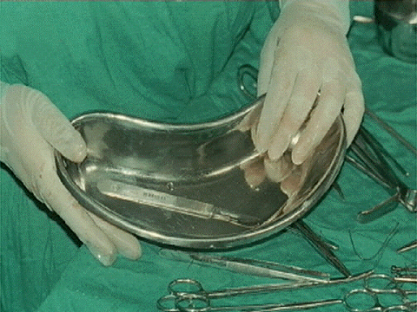
Hands-Free Technique
(7/8)
To maintain sharpness of scalpel blades, use a plastic container or place a sterile cloth in a metal container.

Slide 20
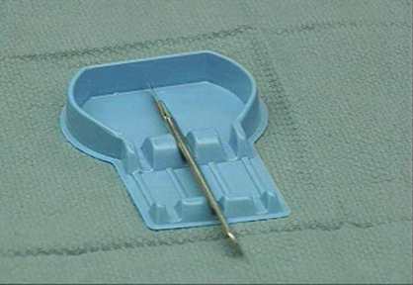
Parking
(8/8)

Slide 21
6. Designing Safer Operations
(1/2)
Using the least dangerous instrument
Brief pre-operative discussion
Anticipating the needs of the surgeon for each step of the operation in advance.
Developing checklists that lay out each step of the operation
Reviewing the checklist with the surgical team

Slide 22
Technique For Using Blunt Needles
(2/2)
Use a strong needle holder and lock it fully
Position the needle in the mid-curve
Grasp and hold the tissue to be sutured with a tissue forceps

Slide 23
summary(1/1)
Surgical care is complex and inv1lves dozens of steps.
Controlling the four main sources of infectious organisms: the patient, surgical staff, the equipment and the operating room environment.
The operating room has special characteristics that increase the chance of accidents.
The “hands-free” technique for passing surgical instruments

